Slide 1
Home Credit Default Risk
Topic: Can you predict how capable each applicant is of repaying a loan ?

Slide 2
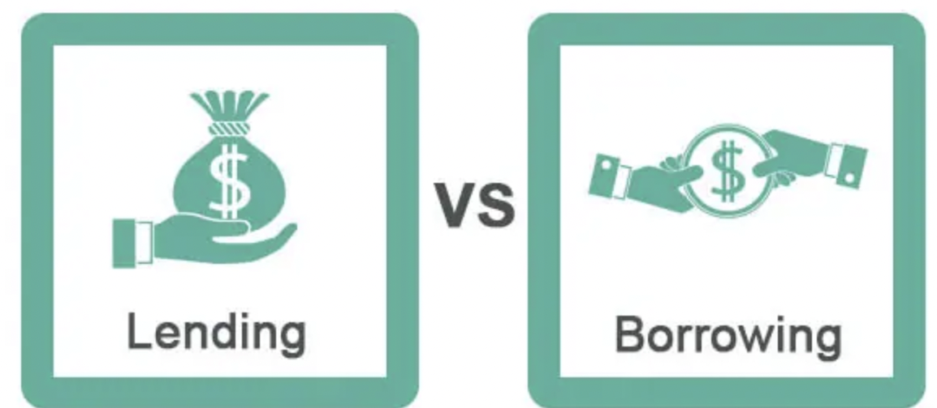
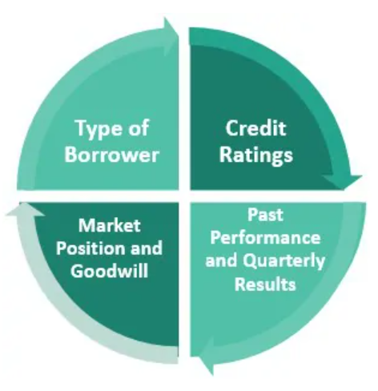
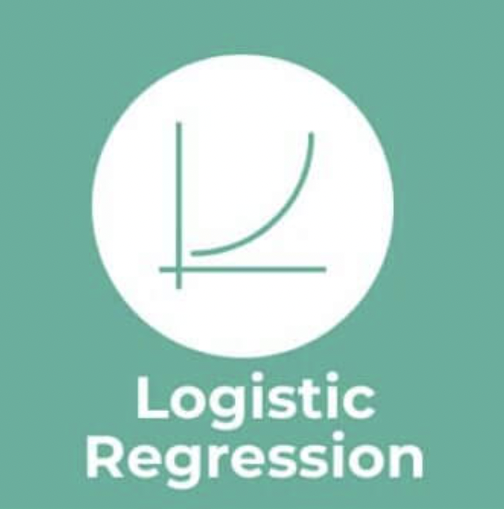
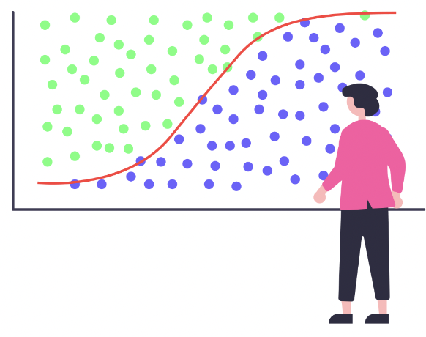
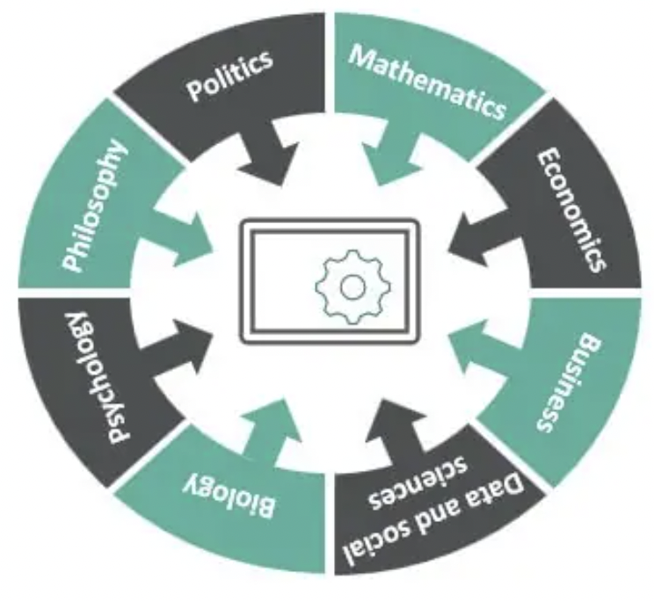

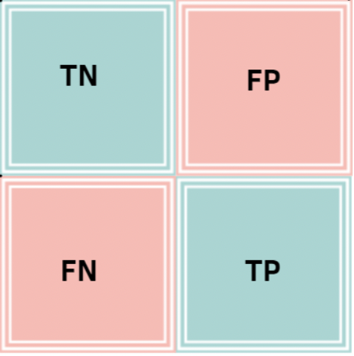
Table of Contents
Problem Statement
2. EDA
3. Machine Learning
4. Findings & Conclusion
5. Recommendations
Understand Severity from both lender and borrower
HomeCredits’ objective
Understand HomeCredit clients behaviour
Relationship
Logistic Regression
KNN
Logistic Regression with PCA
KNN with PCA
Predict best model in future payment behaviour of clients based on findings
HomeCredits’ data scientists promoting several approaches for Management ’ to make final decision

Slide 3
1. Problem Statement

Slide 4



Problem Statement
Background
Founded in 1997
Little or No Credit History
International Consumer Finance Provider
Notes:
Consumer Loans
Cash Loans
Revolving loans

Slide 5


Problem Statement
Business Problems
Revenue
Default

Slide 6
2. EDA

Slide 7
2.1 EDA - Data Description
CSV File Used | app_train.csv | app_test.csv | bureau.csv | Remarks
Rows | 307511 | 48744 | 1716428 | Replace Missing Nos Numerical: Mean Objects: Median
Cols | 123 | 122 | 17
Selected Features | 12 |  | 1
Float | 69 |  | 8
Integer | 41 | 40 | 6
Object | 16 |  | 3
Missing | 147666 | 33347 | 0

Slide 8
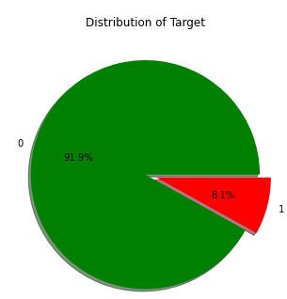
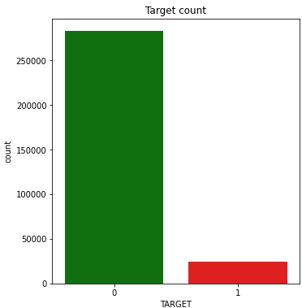
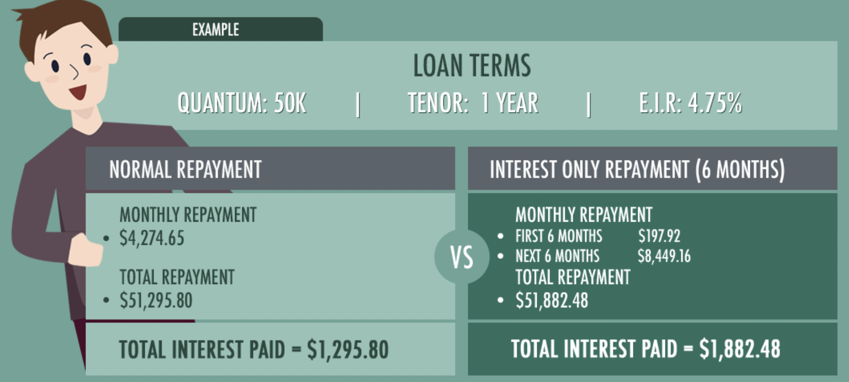
2.2 Let’s first find out % population of people who repays loan on time
8.1% of total loans are defaulted
= Target Variable 1
91.9% of total loans are non-defaulted = Target Variable 0
Defaulted people tend to exhibit some sort of unique behaviours.
Examples: Fraud , Scam and Anomaly detection
As such, we need to focus on such outliers too which could differentiate between defaulters & non-defaulters.
Case Study | Cindy | Anya
Loan Amount | $ 5000 | $ 5000
Number of installments | 36 | 60
Amount of each installment | $159.72 | $104.17
Effective Interest Rate | 9.72% | 9.55%
Total interest payable | $749.92 | $1250.80
Total amount payable | $5749.92 | $6250.80

Slide 9
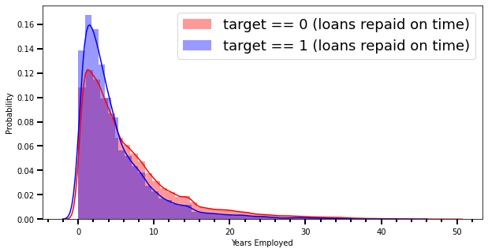
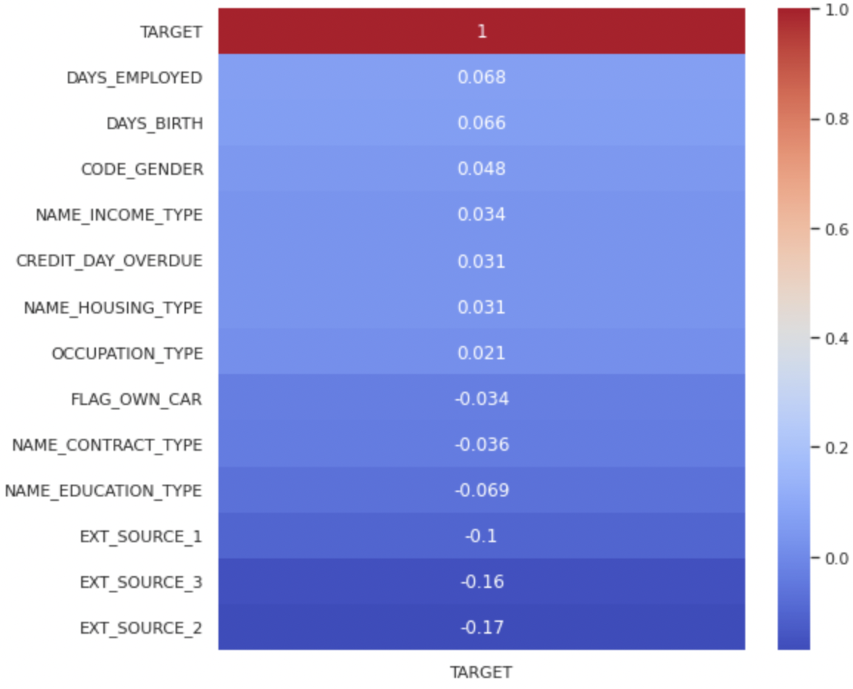



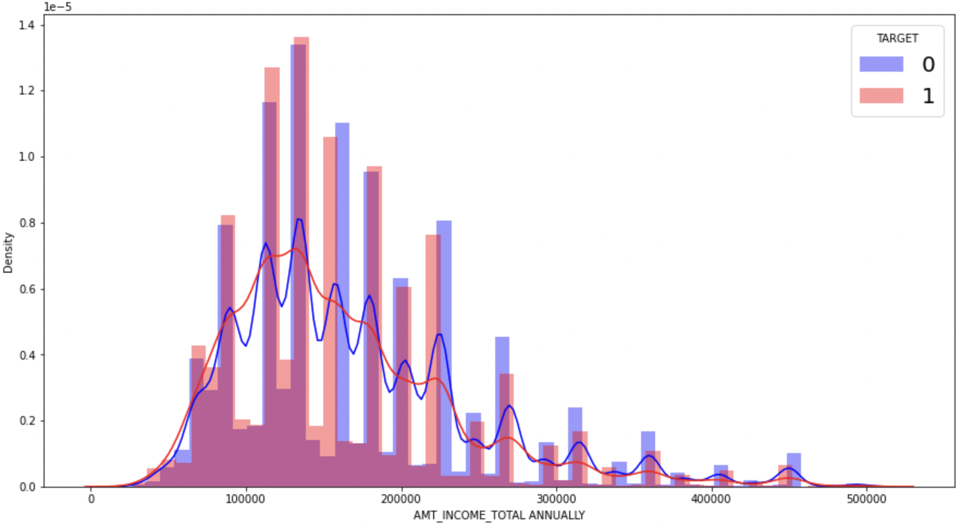
2.3 HomeCredits’ relation to Target whether loans are repaid on-time
Number of years of employment service of accumulated years of income showed heavy dependency on whether loans are defaulted.

Slide 10
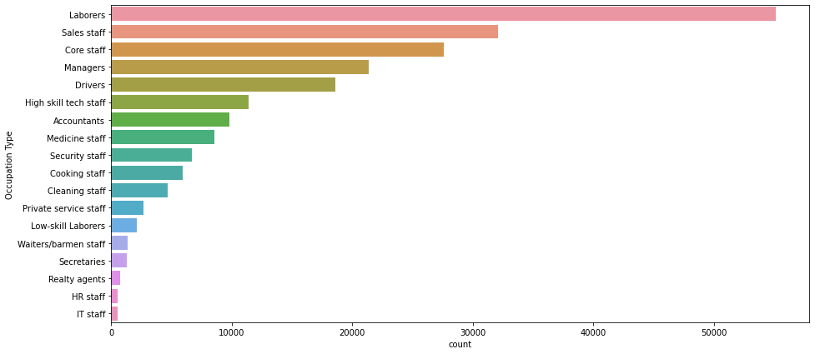
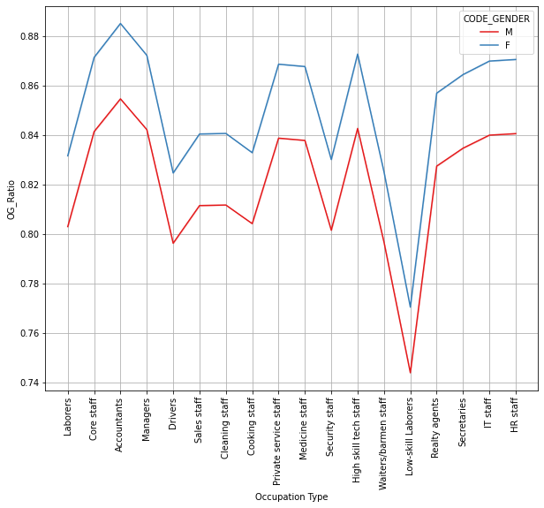
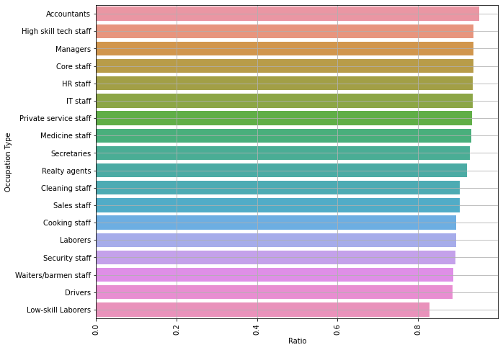
2.4 How does occupation type and Gender correlate with each other in reflection to their behaviour?

Slide 11
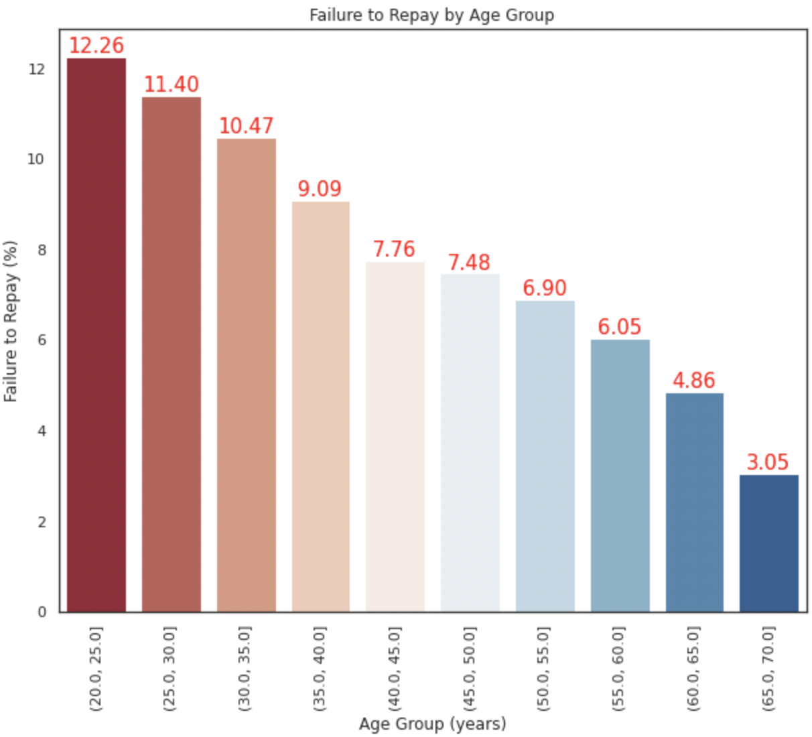
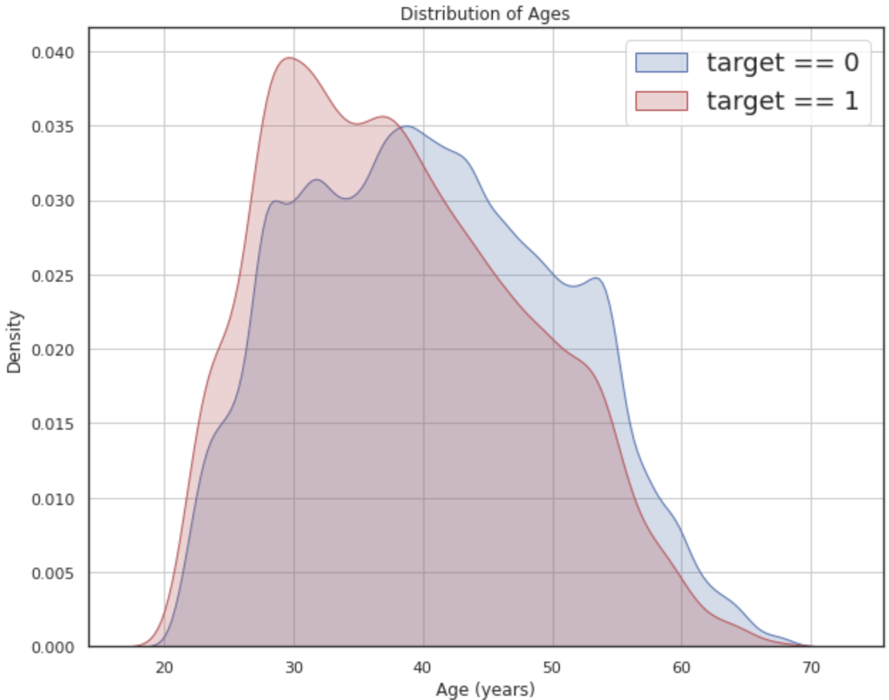
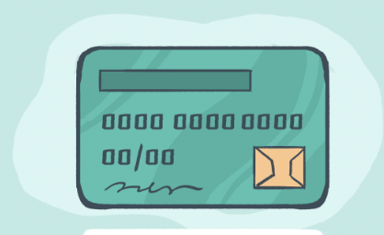




2.5 Age Distribution behaviour on loan repayment

Slide 12
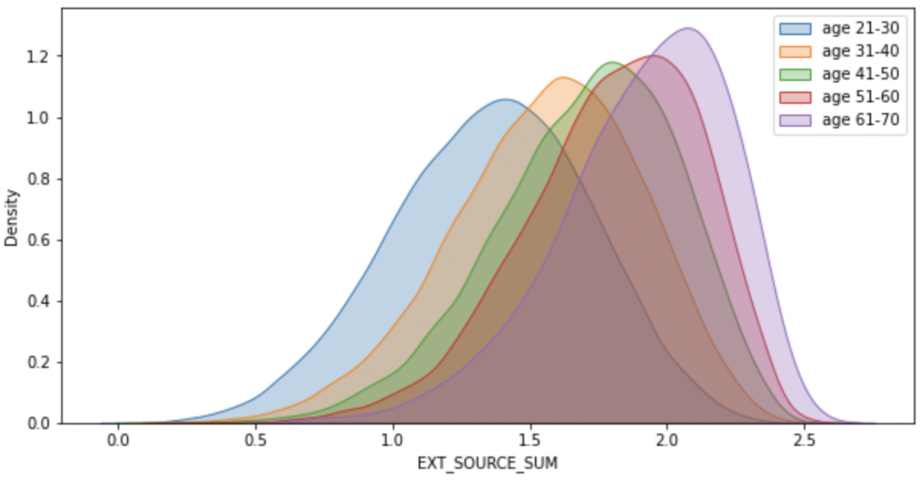
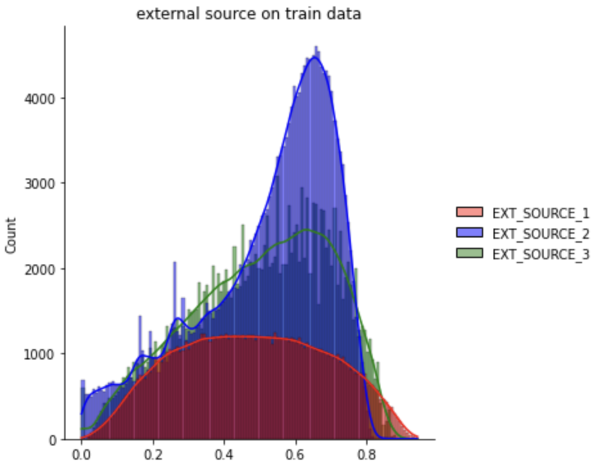
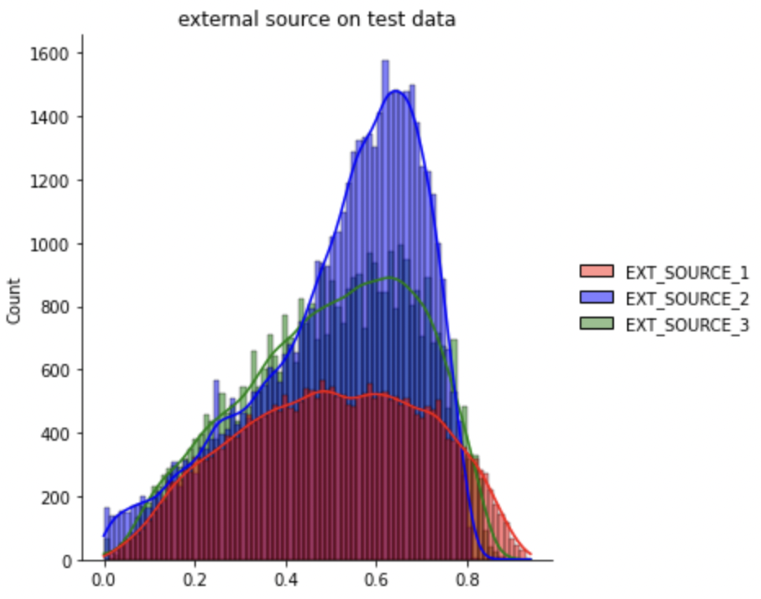
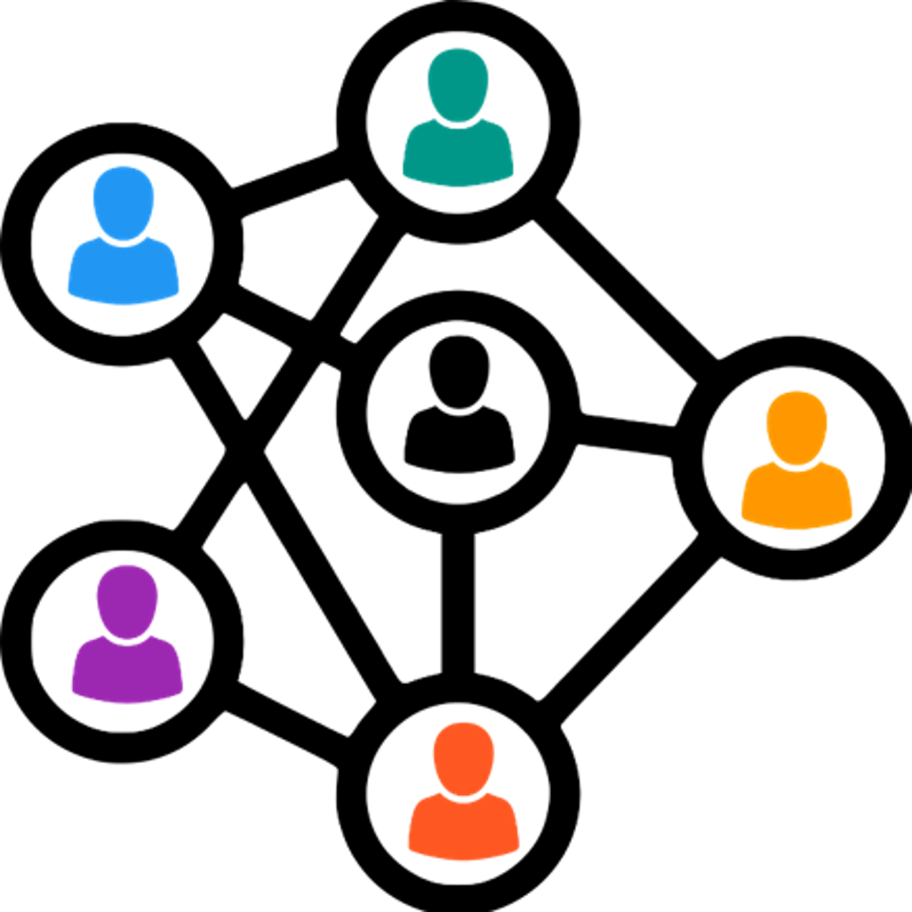
2.6 Population Distribution external source

Slide 13
3. Machine Learning

Slide 14
3.1 Supervising model
Model Set-up & Selection
Dependent Variable: Target Independent Variable: The other remaining features
Model Selection: Linear Regression, K-Nearest Neighbours (KNN)

Slide 15
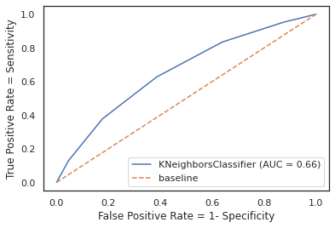
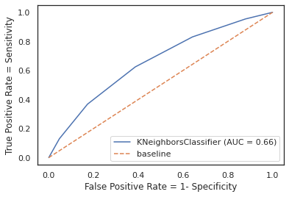
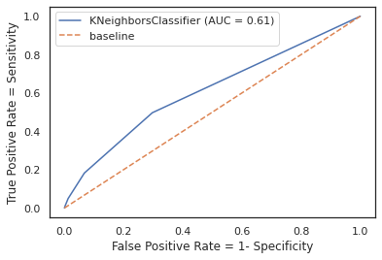
3.2 Visualisations - ROC Curve
KNN
Polynomial - KNN
PCA - KNN
Notes:
ROC to evaluate the output quality -> Larger area under curve

Slide 16
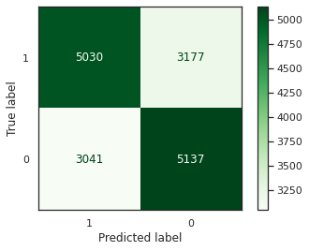
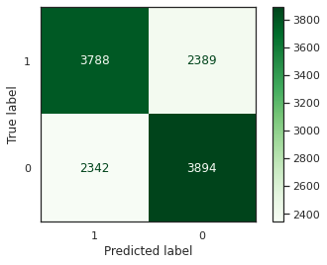
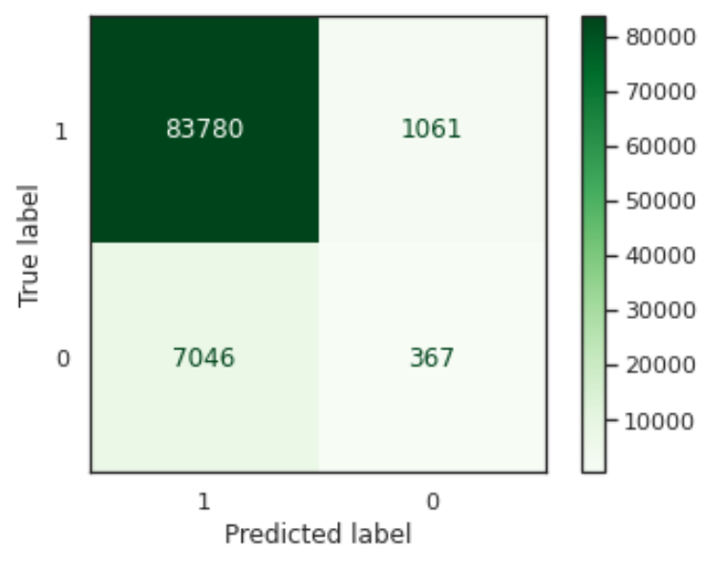
3.3 Visualisations - Confusion Matrix
KNN
Polynomial - KNN
PCA - KNN
Notes:
Should we show the 3d image of the selling price vs engine vs max_power?

Slide 17
5. Findings & Conclusion

Slide 18
4. Findings & Conclusions
Model | Baseline score | Polynomial Features | PCA
Log Regression Train Score | 53.2% | 49.95% | 67.83%
Log Regression Test Score | 52.85% | 50.08% | 67.83%
Model Fit | Good Fit | Good Fit | Good Fit
KNN Train Score | 74.54% | 74.71% | 90.41%
KNN Test Score | 62.05% | 61.87% | 91.48%
Model Fit | Underfit | Underfit | Good Fit

Slide 19
6. Recommendations

Slide 20
6. Recommendations
The impact of the model will benefit the company in the following ways:
Revenue:
Increase Sales Effort
Look for a new market
Extend product range
Upsell
Cross sell
Review pricing constantly
Notes:
Marketing Revenue / Strategies

Slide 21
6. Recommendations
The impact of the model will benefit the company in the following ways:
Operations:
Identify customers not utilizing all your services or products
Use Targeted marketing
Employ a diverse workforce to target specific customer band
Review marketing channels
Stay in touch with your customers using newsletters, holiday cards, or emails.
Provide training to Home Credit Employees on targeted communications strategies
Notes:
Marketing Revenue / Strategies

Slide 22
6. Recommendations
The impact of the model will benefit the company in the following ways: Risk: Identify clients into the following groups:
High Risk Low Volume | High Risk Medium Volume | High Risk High Volume
Medium Risk Low Volume | Medium Risk Medium Volume | Medium Risk High Volume
Low Risk Low Volume | Low Risk Medium Volume | Low Risk High Volume
Risk
Volume
Notes:
Categorise borrowers into matrix based on their income level, Occupation & Gender

Slide 23
6. Recommendations
The impact of the model will benefit the company in the following ways:
Revenue: To understand the characteristics of borrowers that will pay back the loans on time
Operations: Revamp the matrix of criterias based on high correlation features so loan repayment can be improved. I.e. Whether if one owns a car
Risk: Reduce the risk of fraudulent behaviours by borrowers
Notes:
Marketing Revenue / Strategies

Slide 24
7. Further Exploration

Slide 25
7. Further Exploration
Study the rest of the datasets which is not used
Improve the model by monitoring the model
Improve the model by adding more feature
Conduct survey with operations team to understand what other data points might help with the study
Notes:
Marketing Revenue / Strategies

Slide 26
Thank You

